Slide 1

C++
The language in which
operating systems,
compilers,
database management systems,
real time controls,
device drivers
are written!
This presentation is freeware
(C) GEATEC engineering (www.geatec.com)

Slide 2

Headers: Why
// Definition in library module
void greet (int i) {
cout << "Hello, Rotterdam " << i << endl ()
}
// Use in main
if (a > b) {
greet (3.5)

Slide 3
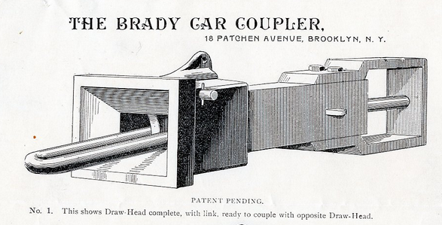
Headers: How (linking pin)
Jukebox.cpp
top layer
= included in
SQL_interpreter.h
MP4_codec.h
middle layer
SQL_interpreter.cppp
MP4_codec.cpp
= inclusion prohibited
File_access.h
Audio_access.h
bottom layer
File_access.cpp
Audio_access.cpp

Slide 4

Headers (include syntax and restrictions)
#include <iostream> // Standard include path
#include “module.h” // Current directory
In this course only class declarations allowed in header
No global #defines, constants, variables c.q instances
No free functions

Slide 5


Some style hints
Avoid redundant comments
rc++; // Increment the record counter
should be
recordCounter++;
Use camel case (except for .NET calls etc.)
ClassNameWithLeadingCapital
allOtherThingsNoLeadingCapital
Avoid needless getters and setters
Because in most C++ programs performance is relevant

Slide 6

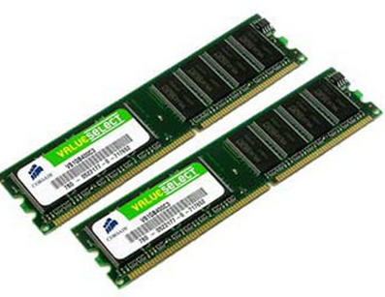
Pointers
int i = 3;
int *pI = &i;
__________________
int *pI = &i, *pJ = &j;
__________________
int *pI = new int;
...
delete pI;

Slide 7
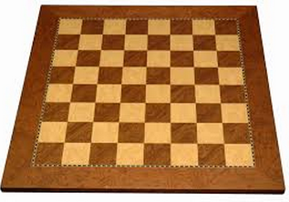
Arrays
float floatArray [10];
// floatArray == &(floatArray [0]);
// anArray [i] == *(anArray + i);
float * floatArray = new float [10];
...
delete [] floatArray;
char *charArray = "Mary";
char charArray2 [5];
strcpy (charArray2, charArray);

Slide 8

Eficient C++: helping the optimizer
void strcpy (char *pDestination, char *pSource) {
while (*pDestination++ = * pSource++);
}
Use this style only where stricktly needed!
(to save a trip to processor dependent assembly language)

Slide 9

References
void increment (int *pI) {
(*pI)++;
}
int a = 3;
increment (&a);
cout << a; // Prints 4
Five spooky chars
void increment (int &i) {
i++;
}
int a = 3;
increment (a);
cout << a; // Prints 4
One spooky char
but same machine code

Slide 10

More references
int i = 3;
int &j = i;
j++;
cout << i; // prints 4
Car &car = country.state.town.street.car;
car = Car ("Volkswagen") ;

Slide 11

And even more references...
float &lowestGrade (float &x, float & y) {
return x < y ? x : y;
/*
if (x < y) {
return x;
}
else {
return y;
}
*/
}
grade1 = 4;
grade2 = 6;
lowestGrade (grade1, grade2) += 2; // grade1 will be 6 after this

Slide 12
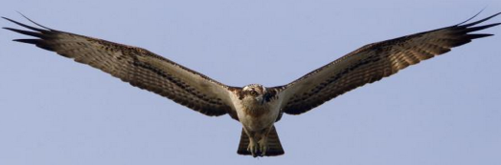


Is it an address operator? Is it a bitwise and? No, it’s super reference !
A REFERENCE IS NOT A KIND OF ADDRESS OPERATOR
How to recognize references:
<type c.q. class> &

Slide 13
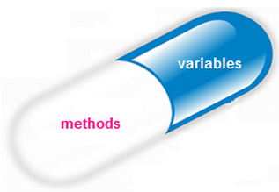
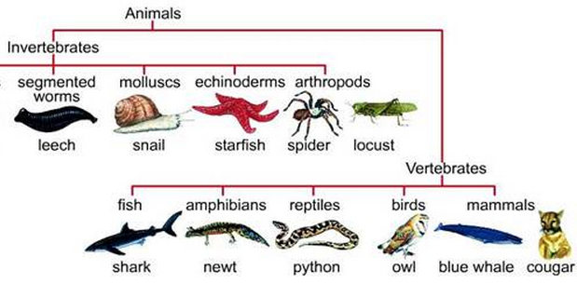
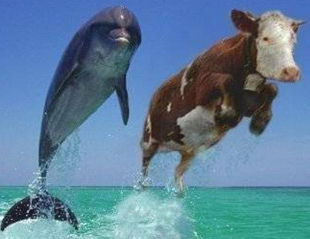
Object orientation =
Encapsulation
+
Inheritance
+
Polymorphism

Slide 14
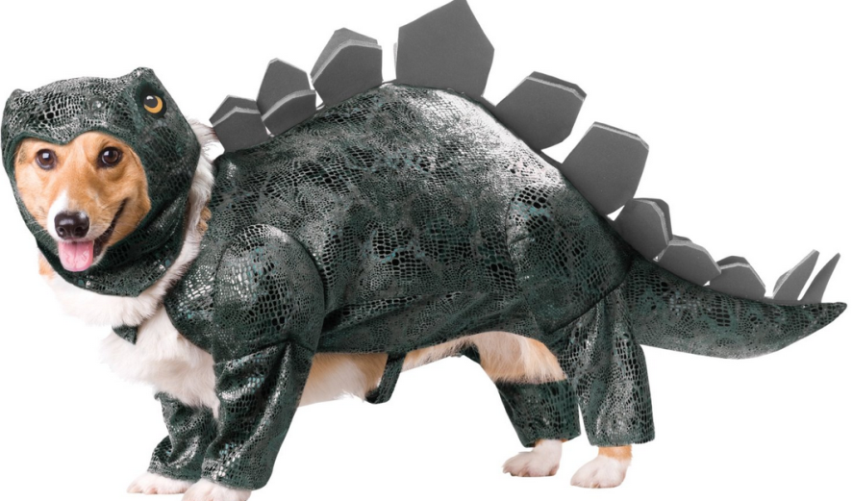

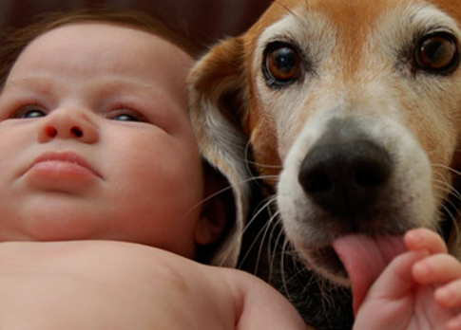
encapsulation inheritance polymorphism
class Dog {
public:
Dog (string name);
void makeSound ();
void tellName () ;
private:
string name;
};
Dog::Dog (string name ): name (name) {}
Dog:: makeSound () {cout << "wraff!" << endl;}
Dog::tellName () {cout << "My name is " << name << endl;}
Dog dog ("Cujo"); // Or: Dog dog = "Cujo"
dog.makeSound ();
dog.tellName ();
Dog *dog2 = new Dog ("Fluffy");
...
delete dog2;

Slide 15


encapsulation inheritance polymorphism
class Dog {
void makeSound ();
};
class PoliceDog: public Dog {
void grabBurglar ();
};
...
PoliceDog brutus;
brutus.makeSound ();
brutus.grabBurglar ();

Slide 16
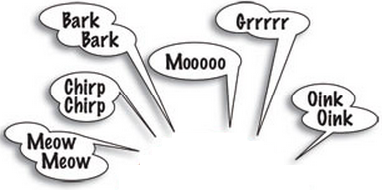
encapsulation inheritance polymorphism
#include "animals.h“
virtual void Dog::speak(){cout<<“Bark";}
virtual void Cat::speak(){cout<<"Meow";}
#include "animals.h“
const int nrOfAnimals = 10;
Animal *animals [nrOfAnimals];
for (int i = 0; i < nrOfAnimals; i++) {
if (i < nrOfAnimals / 2) {
animals [i] = new Dog ();
}
else {
animals [i] = new Cat ();
}
}
for (int i = 0; i < nrOfAnimals; i++) {
animal [i]->speak(); // -> means *().
}
class Animal {
public:
virtual void speak ()=0;
};
class Dog: public Animal {
public:
virtual void speak ();
};
class Cat: public Animal {
public:
virtual void speak ();
};

Slide 17

Literate Programming (Knuth) .h file
void adminGet (TLocator sourceLocator, TContainerId containerId, bool predicted = false);
/*
Actions:
If source locator known
If source locator occupied in stackimage
If containerId parameter differs from containerId in stackimage
Report error
Clear source locator
Else
Report error
Call correctStackimage with parameter sourceLocator
Else
Report error
Assign containerId parameter to spreader locator
Check uniqueness of id of picked up container
If not predicted
Call predictStackImage
Remarks:
Error process will asynchroneously prompt crane driver for eventual unknown id's, spreader locator first
*/

Slide 18

More Literate Programming .cpp file
void adminGet (Locator sourceLocator, ContainerId containerId, bool predicted) {
/*
In the following cases a stored containerId is replaced by a generated one in adminGet:
- Pickup from import location, that is what the import location is for: generating containers
- Pickup from an RTS frame, an occupied frame may have been put into place without notice
*/
int maxReasonableNumberOfAttemptsToGenerateUniqueNegativeContainerId = 1000 * (maxNrOfLocations + maxNrOfTags);
StateGuard stateGuard;
StackImage &stackImage = predicted ? ps : as;
stackImage.version++;
...
}

Slide 19
L.P. for the service team...
IF allocationRequest THEN // If there’s an allocation request
IF autoControl or holdRoute THEN // If the crane already has been allocated
allocationRefused.latch; // Report refusal of double allocation
ELSE // If the crane has not yet been allocated
allocationAttempt.latch; // Try to allocate it
ENDIF
ENDIF
#define IF _if (
#define THEN );
#define ELSIF _elsif (
#define ELSE _else ();
#define ENDIF _endif ();
inline void _if (int boolExpres) {
boolLevel++;
boolContext [boolLevel] = boolContext [boolLevel - 1] && boolExpres;
boolMemo [boolLevel] = boolExpres;
}

Slide 20
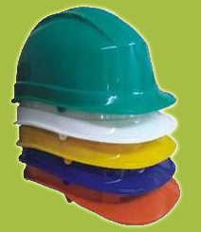
Constructor overloading
class Matrix { // No constructor declared, still class has constructor Matrix ()
private:
float **contents;
}
Matrix::Matrix (int nrOfRows,int nrOfColumns, float **contents) {...}
// Hides Matrix::Matrix () to prevent accidental misconstruction
Matrix::Matrix (): Matrix (0, 0, 0) {...}
// Matrix () has now been reintroduced, using the Matrix (int, int, int)
Matrix::Matrix (Matrix &matrix) {...}
/*
Copy constructor:
- Allocate dynamic memory for the contents
- Make the contents field of the object under construction point to that memory
- Copy the contents from the parameter into this dynamic memory
*/

Slide 21

Destructors are called automatically
Code in destructors should explicitly release system resources like heap memory, file descriptors and semaphores
May cause a memory leak in a polymorphic situation:
Matrix::~Matrix () {...}
Won’t cause a leak:
virtual Matrix::~Matrix () {...}

Slide 22
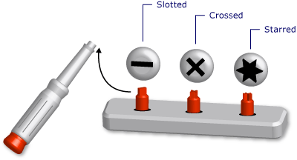
Function templates
<template class Number>
Number add (Number n1, Number n2) {
return n1 + n2;
}
float x = add (3.14, 2.72);
int x = add (10, 20);
string s = add ("fiets" + "pomp")
float add (float n1, float n2) {
return n1 + n2;
}
int add (int n1, int n2) {
return n1 + n2;
}
string add (string n1, string n2) {
return n1 + n2;
}

Slide 23
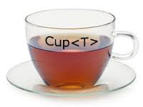
Class templates
template <class Number>
class Complex {
public:
Number realPart;
Number imaginaryPart;
Number getNorm ();
};
Number Complex <Number>::getNorm () {
return sqrt (realPart * realPart + imaginaryPart * imaginaryPart);
}
Complex <float> complex1;
Complex <double> complex2;
typedef Complex <float > FloatComplex;
FloatComplex complex3;

Slide 24

Templates: sometimes a mouth full...
template <class T>
Matrix <T>:: Matrix<T> (Matrix<T> &matrix): Matrix <T> () {
...
}

Slide 25

Operator overloading as friend
class Matrix {
public:
Matrix (float scalar);
friend Matrix multiply (Matrix &m1, Matrix &m2);
friend Matrix operator* (Matrix &m1, Matrix &m2);
private:
float ** contents;
};
Matrix::Matrix (float scalar)...
Matrix multiply (Matrix &m1, Matrix &m2)...
Matrix operator* (Matrix &m)...
m3 = multiply (m1, m2);
m3 = operator* (m1, m2);
m3 = m1 * m2;
m3 = m1 * 3;
m3 = 3 * m1;

Slide 26

Operator overloading as member
class Matrix {
public:
Matrix (float scalar);
Matrix multiply (Matrix &m);
Matrix operator* (Matrix &m);
private:
float ** contents;
};
Matrix::Matrix (float scalar)...
Matrix Matrix::multiply (Matrix &m)...
Matrix Matrix::operator* (Matrix &m)...
m3 = m1.multiply (m2);
m3 = m1.operator* (m2);
m3 = m1 * m2;
m3 = m1 * 3;
m3 = 3 * m1;

Slide 27
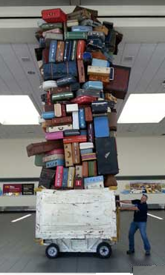


Operator overloading and performance 1
Matrix operator* (
Matrix &operand1,
Matrix &operand2
);
Matrix &operator* (
Matrix &operand1,
Matrix &operand2
);
void multiply (
Matrix &result,
Matrix &operand1,
Matrix &operand2
);

Slide 28

Operator overloading and performance 2 Transferring ownership with rvalue refs
Matrix::Matrix (Matrix&& matrix) : contents (matrix.contents) { matrix.contents = nullptr;
}
Matrix & operator= (Matrix && mat) {
delete [] contents;
contents = matrix.contents;
matrix.contents = nullptr;
return *this;
}

Slide 29

Some special operators
Matrix &Matrix::operator= (Matrix &matrix) {
...
return *this;
}
(matrix3 = matrix1) = matrix2;
float *Matrix::operator[] (int rowIndex) {
return contents [rowIndex];
}
float x = matrix [2][3];
float &Matrix::operator() (int rowIndex, int columnIndex) {
return contents [rowIndex][columnIndex];
}
float x = matrix (2, 3);

Slide 30
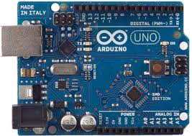
Bit operations (examples 8bit unsigned)
3 & 5 == 1
1 | 2 == 3
1 ^ 3 == 2
~254 == 1
16 >> 2 == 4
16 << 2 == 64

